Slide 1
NAME : KOKILA U
REG NO : 513121104016
COLLEGE NAME : THANTHAI PERIYAR GOVERNMENT
INSTITUTE OF TECHNOLOGY
DEPARTMENT : COMPUTER SCIENCE AND ENGINEERING
YEAR : THIRD YEAR
NM ID : au513121104016
SKILL BUILD ID : kokilaumasankar181003gmail.com
PROJECT TITLE : SUDOKU SOLVER IN PYTHON USING CNN

Slide 2
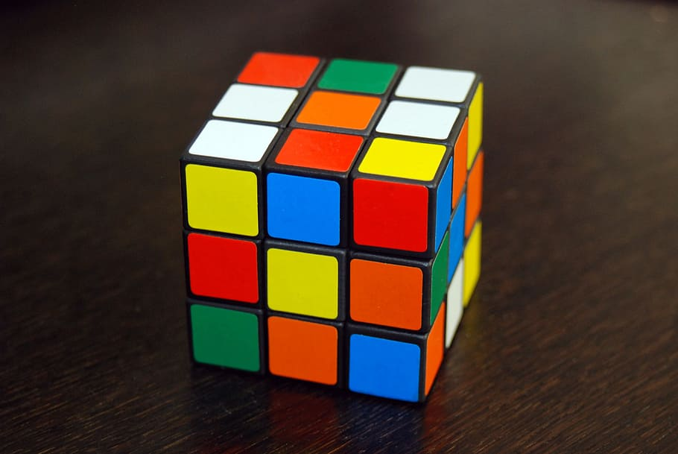
SUDOKU SOLVER IN PYTHON USING CNN

Slide 3
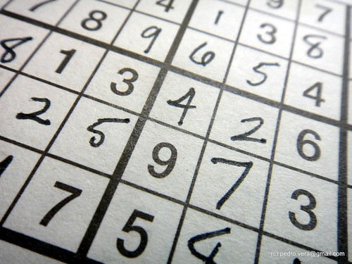
AGENDA
INTRODUCTION
SUDOKU PUZZLE OVERVIEW
APPROACH AND METHODOLOGY
MODEL ARCHITECTURE
RESULT AND CONCLUSION
This Photo by Unknown author is licensed under CC BY-NC-ND.

Slide 4
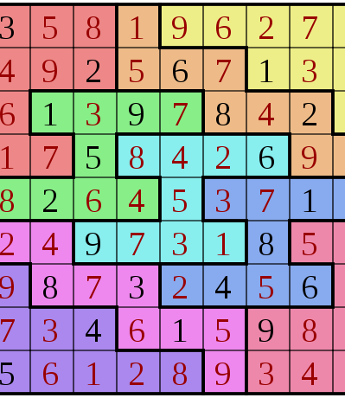
INTRODUCTION
Introduce the topic: "Sudoku Solver Using Convolutional Neural Networks".
Briefly explain the goal of the project: to develop an AI-based system capable of solving Sudoku puzzles automatically.
Mention that the approach involves using Convolutional Neural Networks (CNNs), a type of deep learning model commonly used for image processing tasks.
This Photo by Unknown author is licensed under CC BY-SA.

Slide 5

SUDOKU PUZZLE OVERVIEW
Provide an overview of Sudoku puzzles.
Explain the rules: a 9x9 grid divided into nine 3x3 subgrids, where the objective is to fill each row, column, and subgrid with numbers from 1 to 9 without repetition.
Show an example Sudoku puzzle to illustrate.
This Photo by Unknown author is licensed under CC BY-SA.

Slide 6
APPROACH AND METHODOLOGY FOR SUDOKU
Explain the methodology used for solving Sudoku puzzles using CNNs.
Describe the steps involved:
Data Preparation: Collecting a dataset of Sudoku puzzles and their solutions.
Model Architecture: Designing a CNN architecture capable of learning to solve Sudoku puzzles.
Training: Training the CNN model on the dataset to learn the patterns and relationships in Sudoku puzzles.
Evaluation: Assessing the performance of the trained model on test data.
Inference: Using the trained model to solve new Sudoku puzzles.

Slide 7
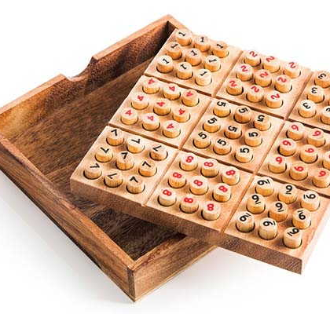
MODEL ARCHITECTURE FOR SUDOKU
Provide details about the CNN architecture used for solving Sudoku puzzles.
Describe the layers of the model:
Input Layer: Accepts a 9x9 grid representation of Sudoku puzzles.
Convolutional Layers: Extract features from the input grid.
Flatten Layer: Converts the output of convolutional layers into a 1D array.
Dense Layer (Output Layer): Predicts the digits for each cell in the Sudoku grid.
Include a diagram illustrating the architecture.
This Photo by Unknown author is licensed under CC BY-SA-NC.

Slide 8
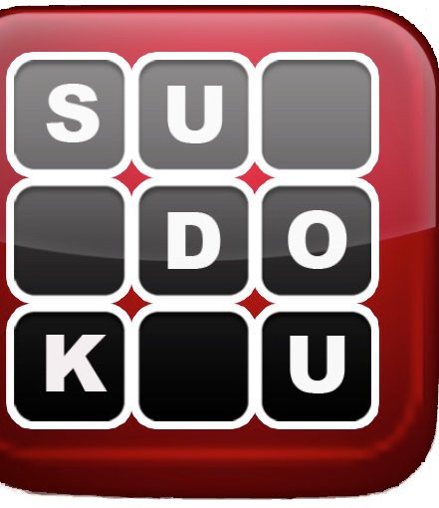
RESULT
Present the results of the Sudoku solver model:
Accuracy: Measure the accuracy of the model in solving Sudoku puzzles.
Performance: Discuss the speed and efficiency of the model in solving puzzles.
This Photo by Unknown author is licensed under CC BY-SA-NC.

Slide 9
CONCLUSION
Conclusion: Summarize the key findings and contributions of the project.
Future Work: Mention potential areas for future improvement or research, such as optimizing the model architecture, exploring alternative approaches, or developing a user-friendly Sudoku solver application.
This outline provides a structured framework for creating a PowerPoint presentation on the topic of "Sudoku Solver Using Convolutional Neural Networks". You can expand on each slide with additional details, visuals, and examples to make the presentation more engaging and informative.

